Slide 1
Building Biochemical + Chemical Similarity Networks
Dmitry Grapov, PhD
040413

Slide 2
The ingredients
List of chemical identifiers
Preferably - Pubchem compound identifiers (CIDs)
Edge List (calculate from identifiers or database)
Table of Edge/Node Attributes (calculate from data or database)
Visualization

Slide 3
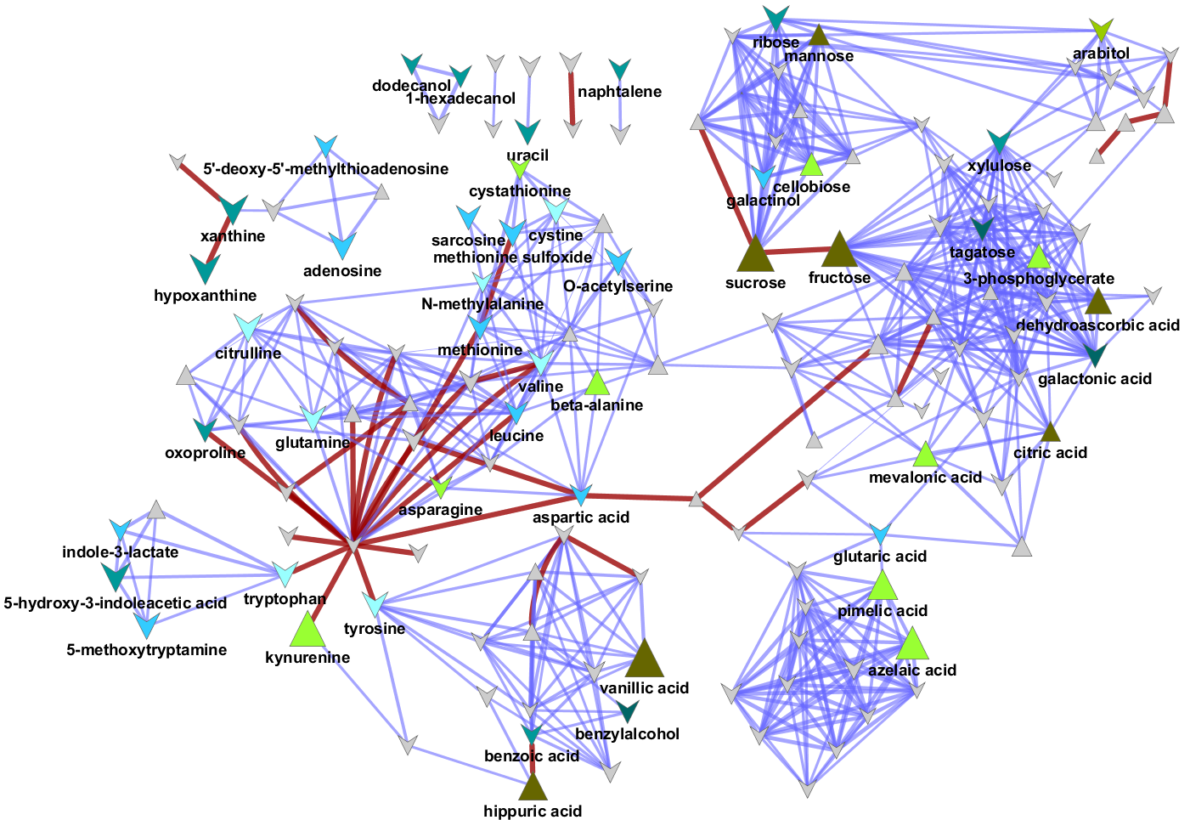
Some Examples
Biochemical relationships + chemical similarity + correlation + statistics + PLS-DA

Slide 4
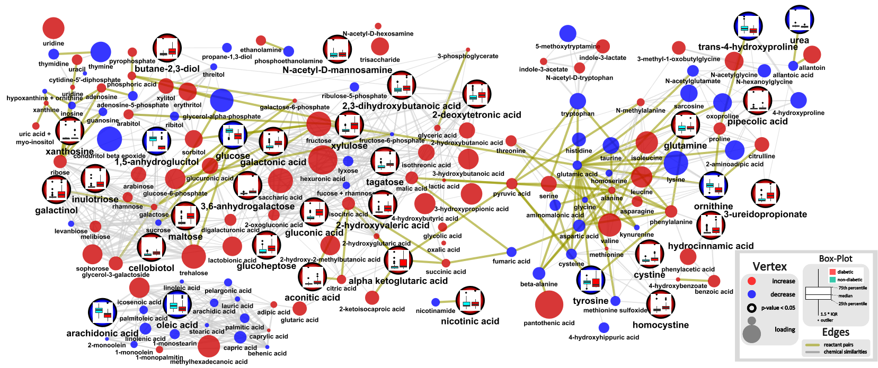
Biochemical relationships + chemical similarity + correlation + statistics + PLS-DA + graphs

Slide 5
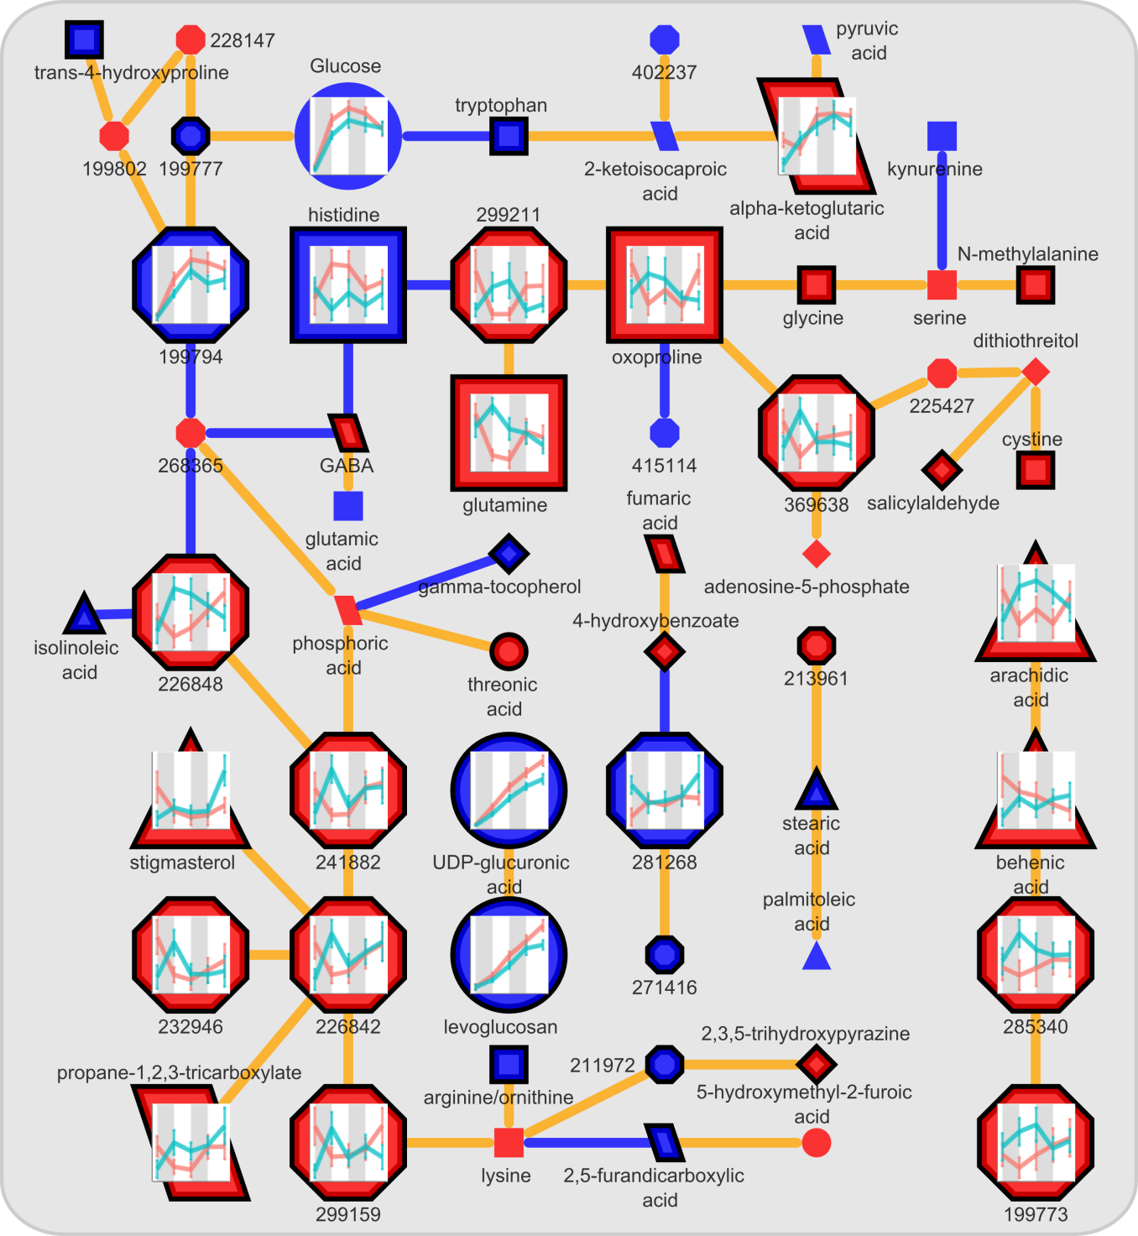
partial correlation + PLS-DA + statistics + graphs

Slide 6
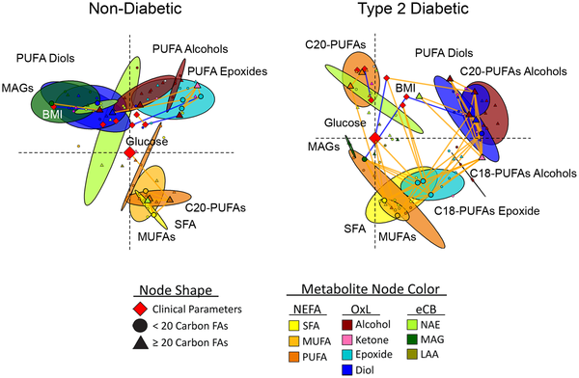
correlation + class information + clustering + PLS-DA + MDS

Slide 7
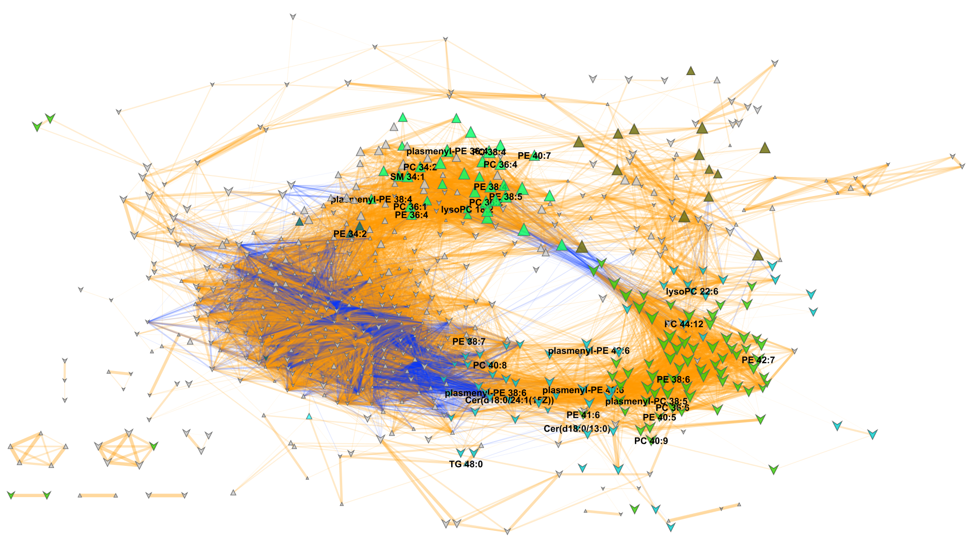
correlation + clustering + OSC-PLS-DA + Statistics

Slide 8
The ingredients
List of chemical identifiers
Preferably - Pubchem compound identifiers (CIDs)
Edge List (calculate from identifiers or database)
Table of Edge/Node Attributes (calculate from data or database)
Visualization

Slide 9
Edge List
KEGG RPAIRS
Tanimoto distances
Other options
correlations
partial-correlations
similarity/dissimilarity measures
(optional) edge attributes

Slide 10
Node Attributes Table
Options for node mapping
Continuous: size, transparency, boarder width, color
Discreet: color, shape, label
Other: node graphics

Slide 11
Demonstration
Get nessesary R code
chemical identifiers
Import into R
Create KEGG RPAIRs edge list
Create Tanimoto similarity edge list
Node attributes table

Slide 12
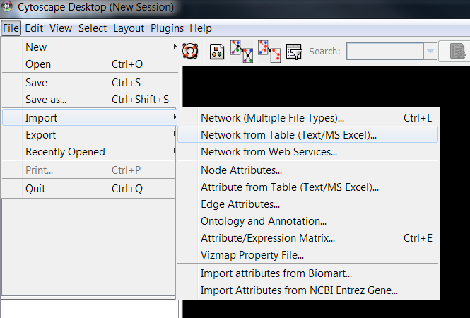
Visualizing network in Cytoscape
1) Up load edge list
(save as excel file first)

Slide 13
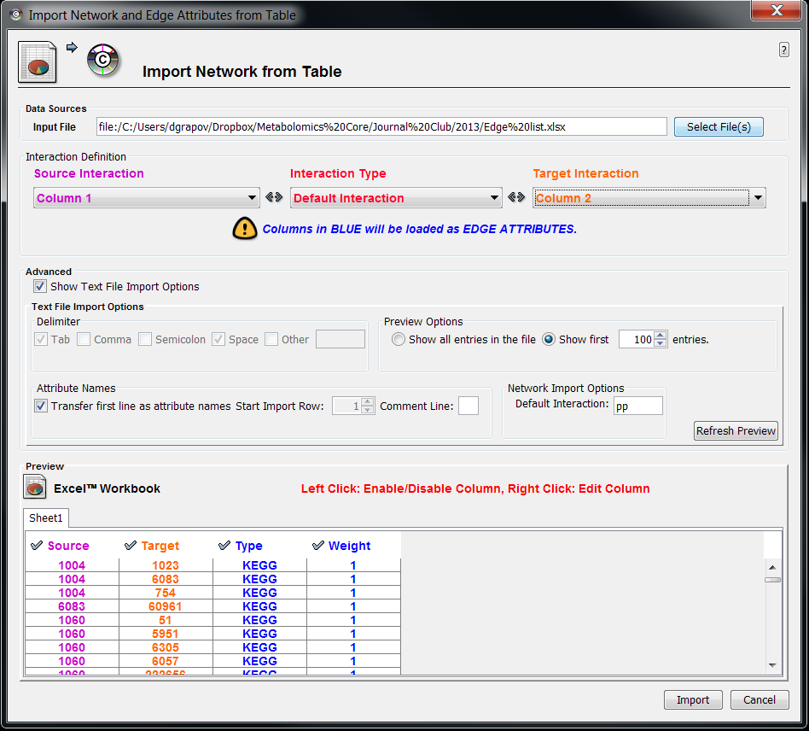
Visualizing network in Cytoscape
1) Up load edge list

Slide 14
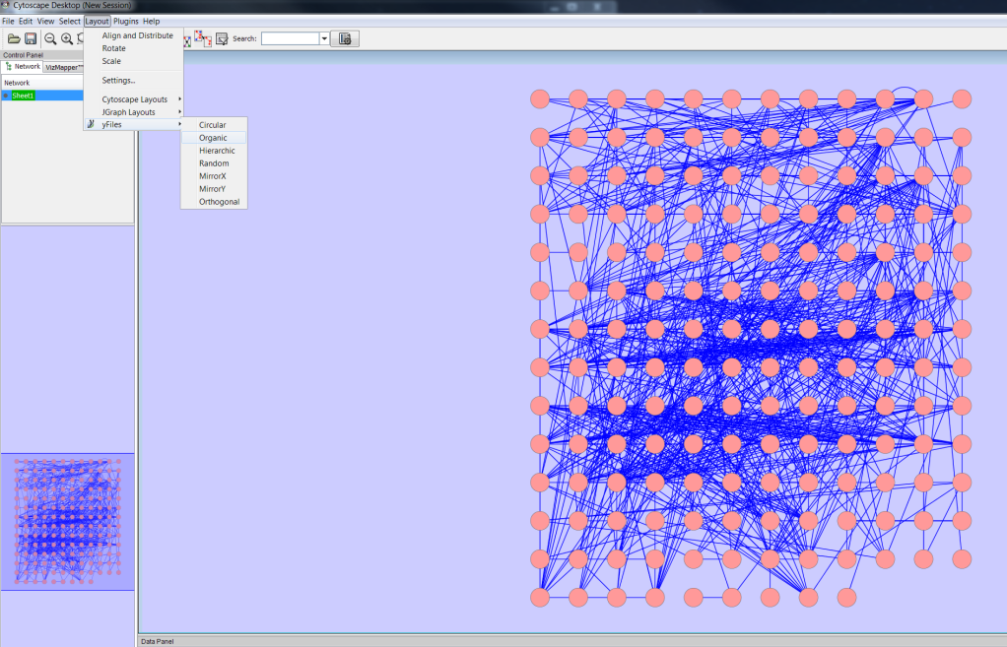
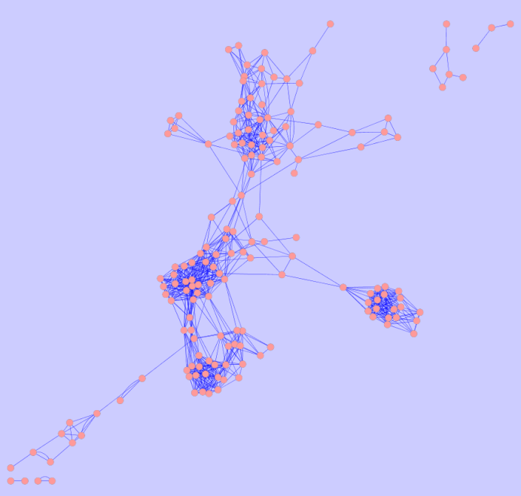
Visualizing network in Cytoscape
Change layout

Slide 15
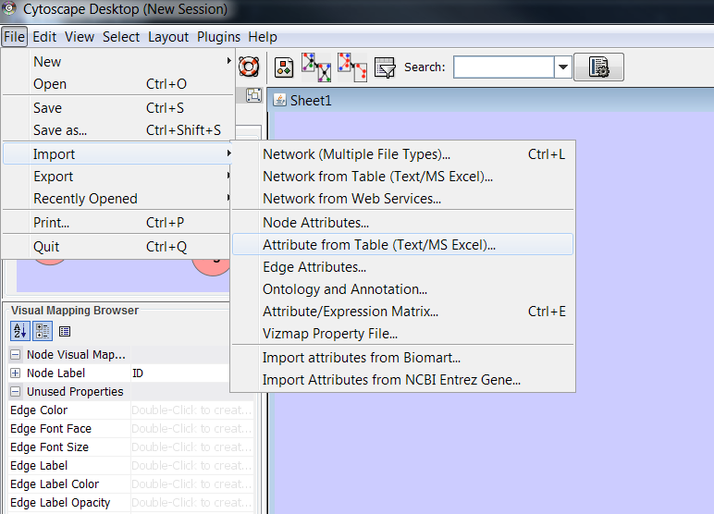
Visualizing network in Cytoscape
2) Up load node attributes file

Slide 16
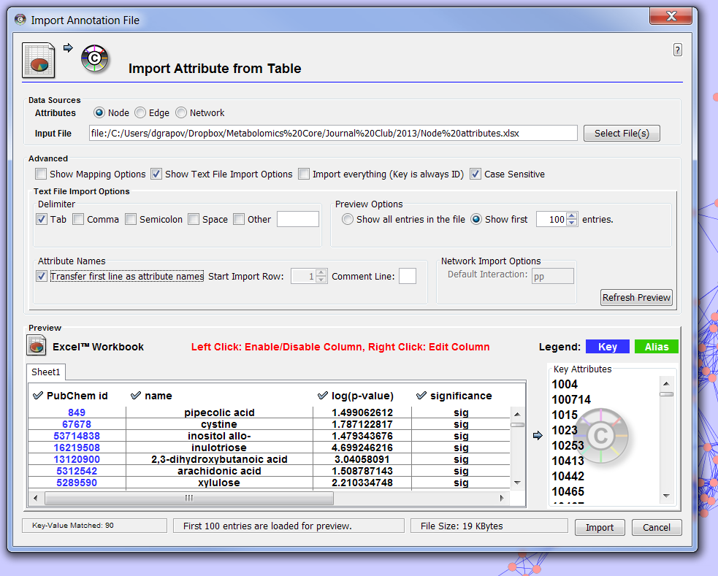
Visualizing network in Cytoscape
2) Up load node attributes file

Slide 17
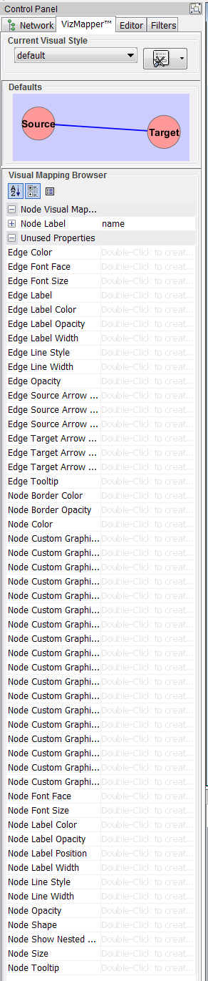
Visualizing network in Cytoscape
3) Map node and edge attributes

Slide 18
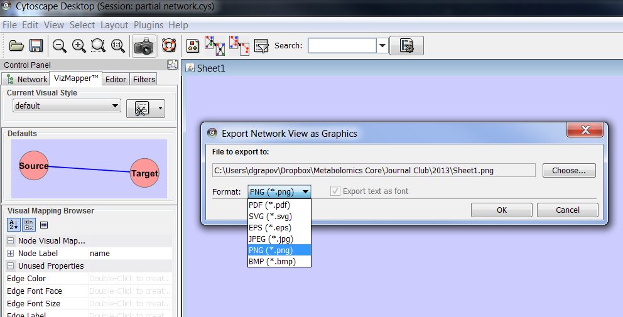
Visualizing network in Cytoscape
4)When done export network to favorite file format

